Slide 1
INDIAN CULTURE

Slide 2
CONTENTS
INTRODUCTION
NAMASKAR
RELIGIONS AS SPIRITUALITY
LANGUAGES AS LITRATURE
FOOD
MARRIGE
FASTIVAL
CLOTHING
MUSIC AS DANCE
TEMPLE

Slide 3
INTRODUCTION
India is part of the continent of Asia. Most of India forms a peninsula, which means it is surrounded by
water on three sides. The world's highest mountain range, the Himalaya, rises in the north.
The southeast is bordered by the Bay of Bengal, and the southwest is bordered by the Arabian Sea.

Slide 4
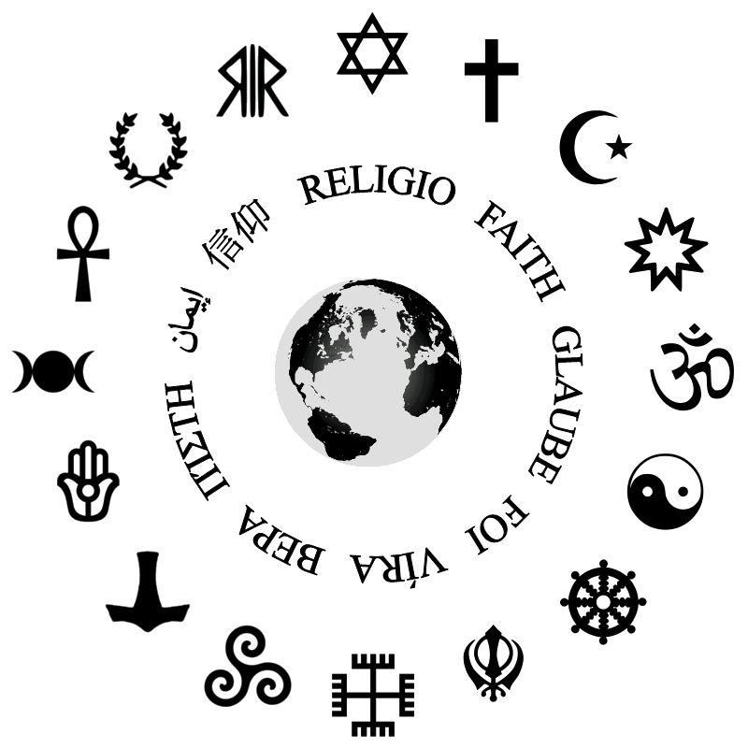
RELIGIONS AS SPIRITUALITY
India is birth place of many religions
Like Hinduism , buddhism , muslim and ect.
Hindu and muslim are the world 3rd as 4th largest religions
India respect all religions
Indian is secular

Slide 5
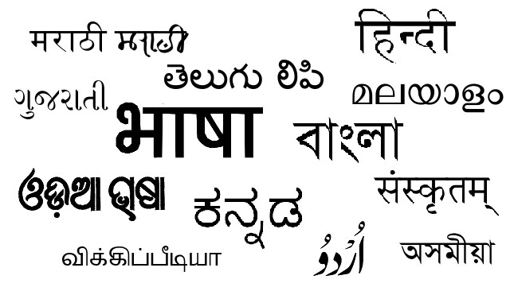
Languages as literature
16. Konkani
17. Kasmiri
18.Bodo
19. Dogri
20.Nagpuri
21. Maithili
22.Brech
Hindi
Bengali
Marathi
Gujarati
Punjabi
Odia
Assamese
Tamil
Telugu
Kannada
Malayalam
Haryanvi
Bhojpuri
sanskrit
Urdu

Slide 6
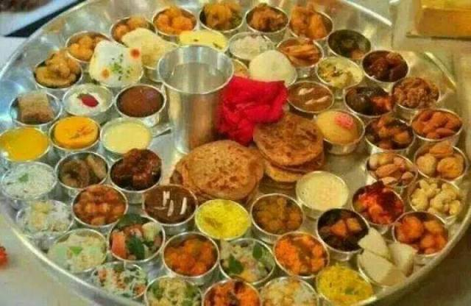
Food
Here is the list of 29 Indian Traditional Food - Indian States and Their Food Items to Awaken your Taste Buds
Misal Pav - Maharashtra. ...
Makki di Roti and Sarson da Saag - Punjab. ...
Kosha Mangsho - West Bengal. ...
Dhokla - Gujarat. ...
Rogan Josh - Kashmir. ...
Pongal - Tamil Nadu. ...
Papaya Khar - Assam. ...
Litti Chokha - Bihar.

Slide 7
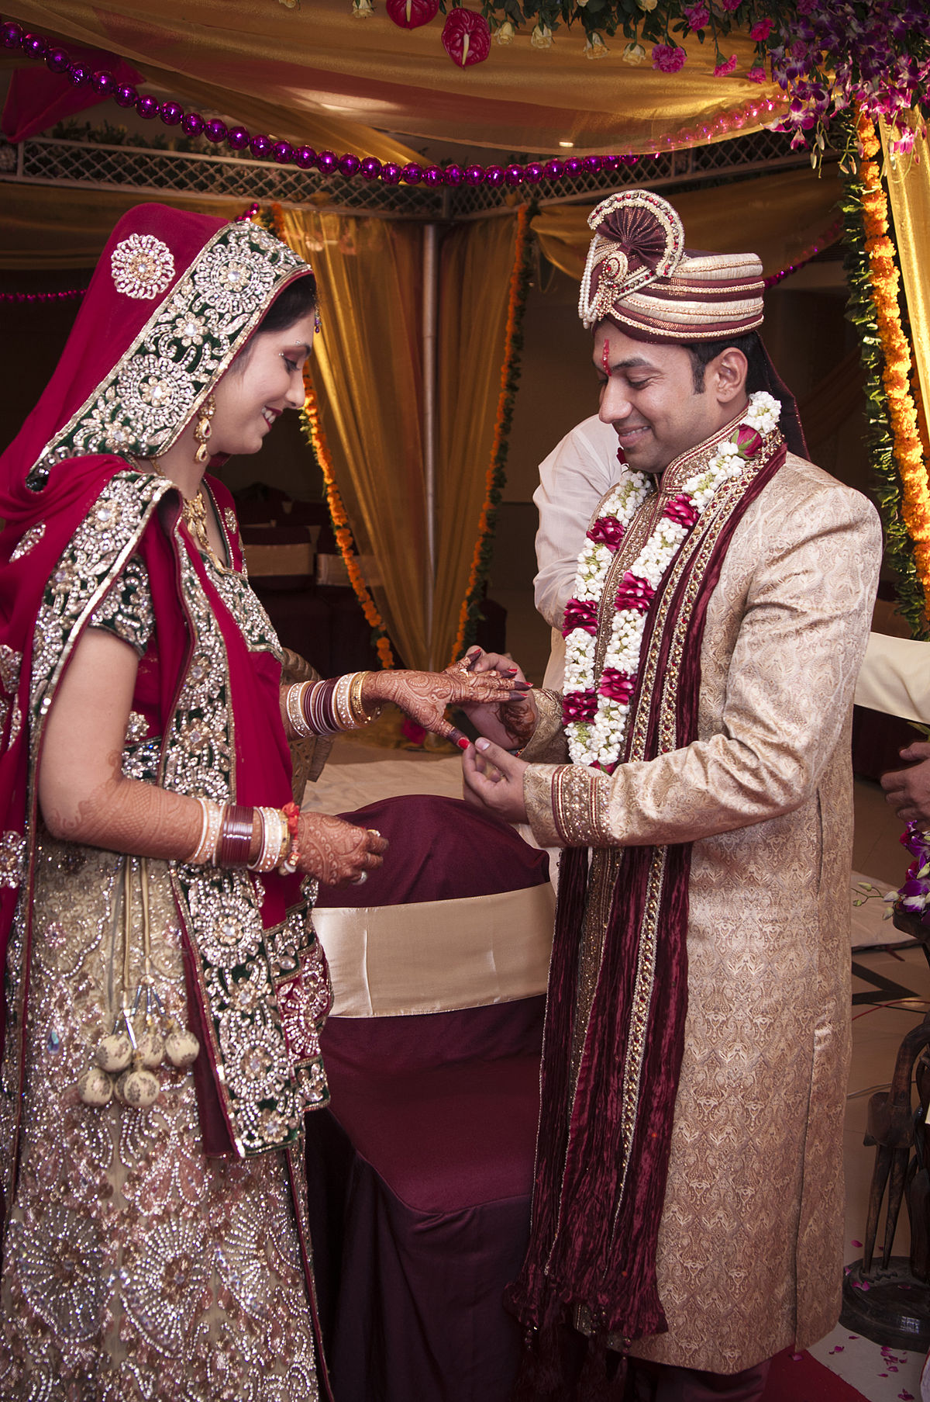
marrige
In india by law and tradition , no hindu marrige is binding
Or complete unless the ritual of seven steps vows in presence
Of fire (saptapadi) is completed

Slide 8
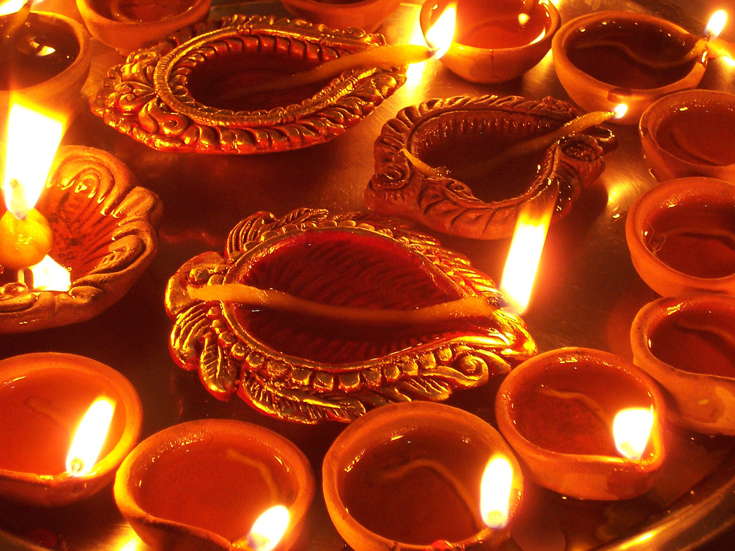
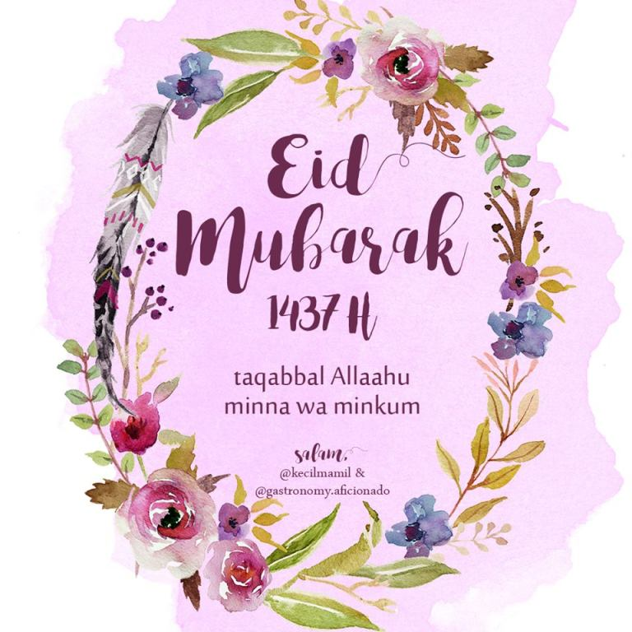
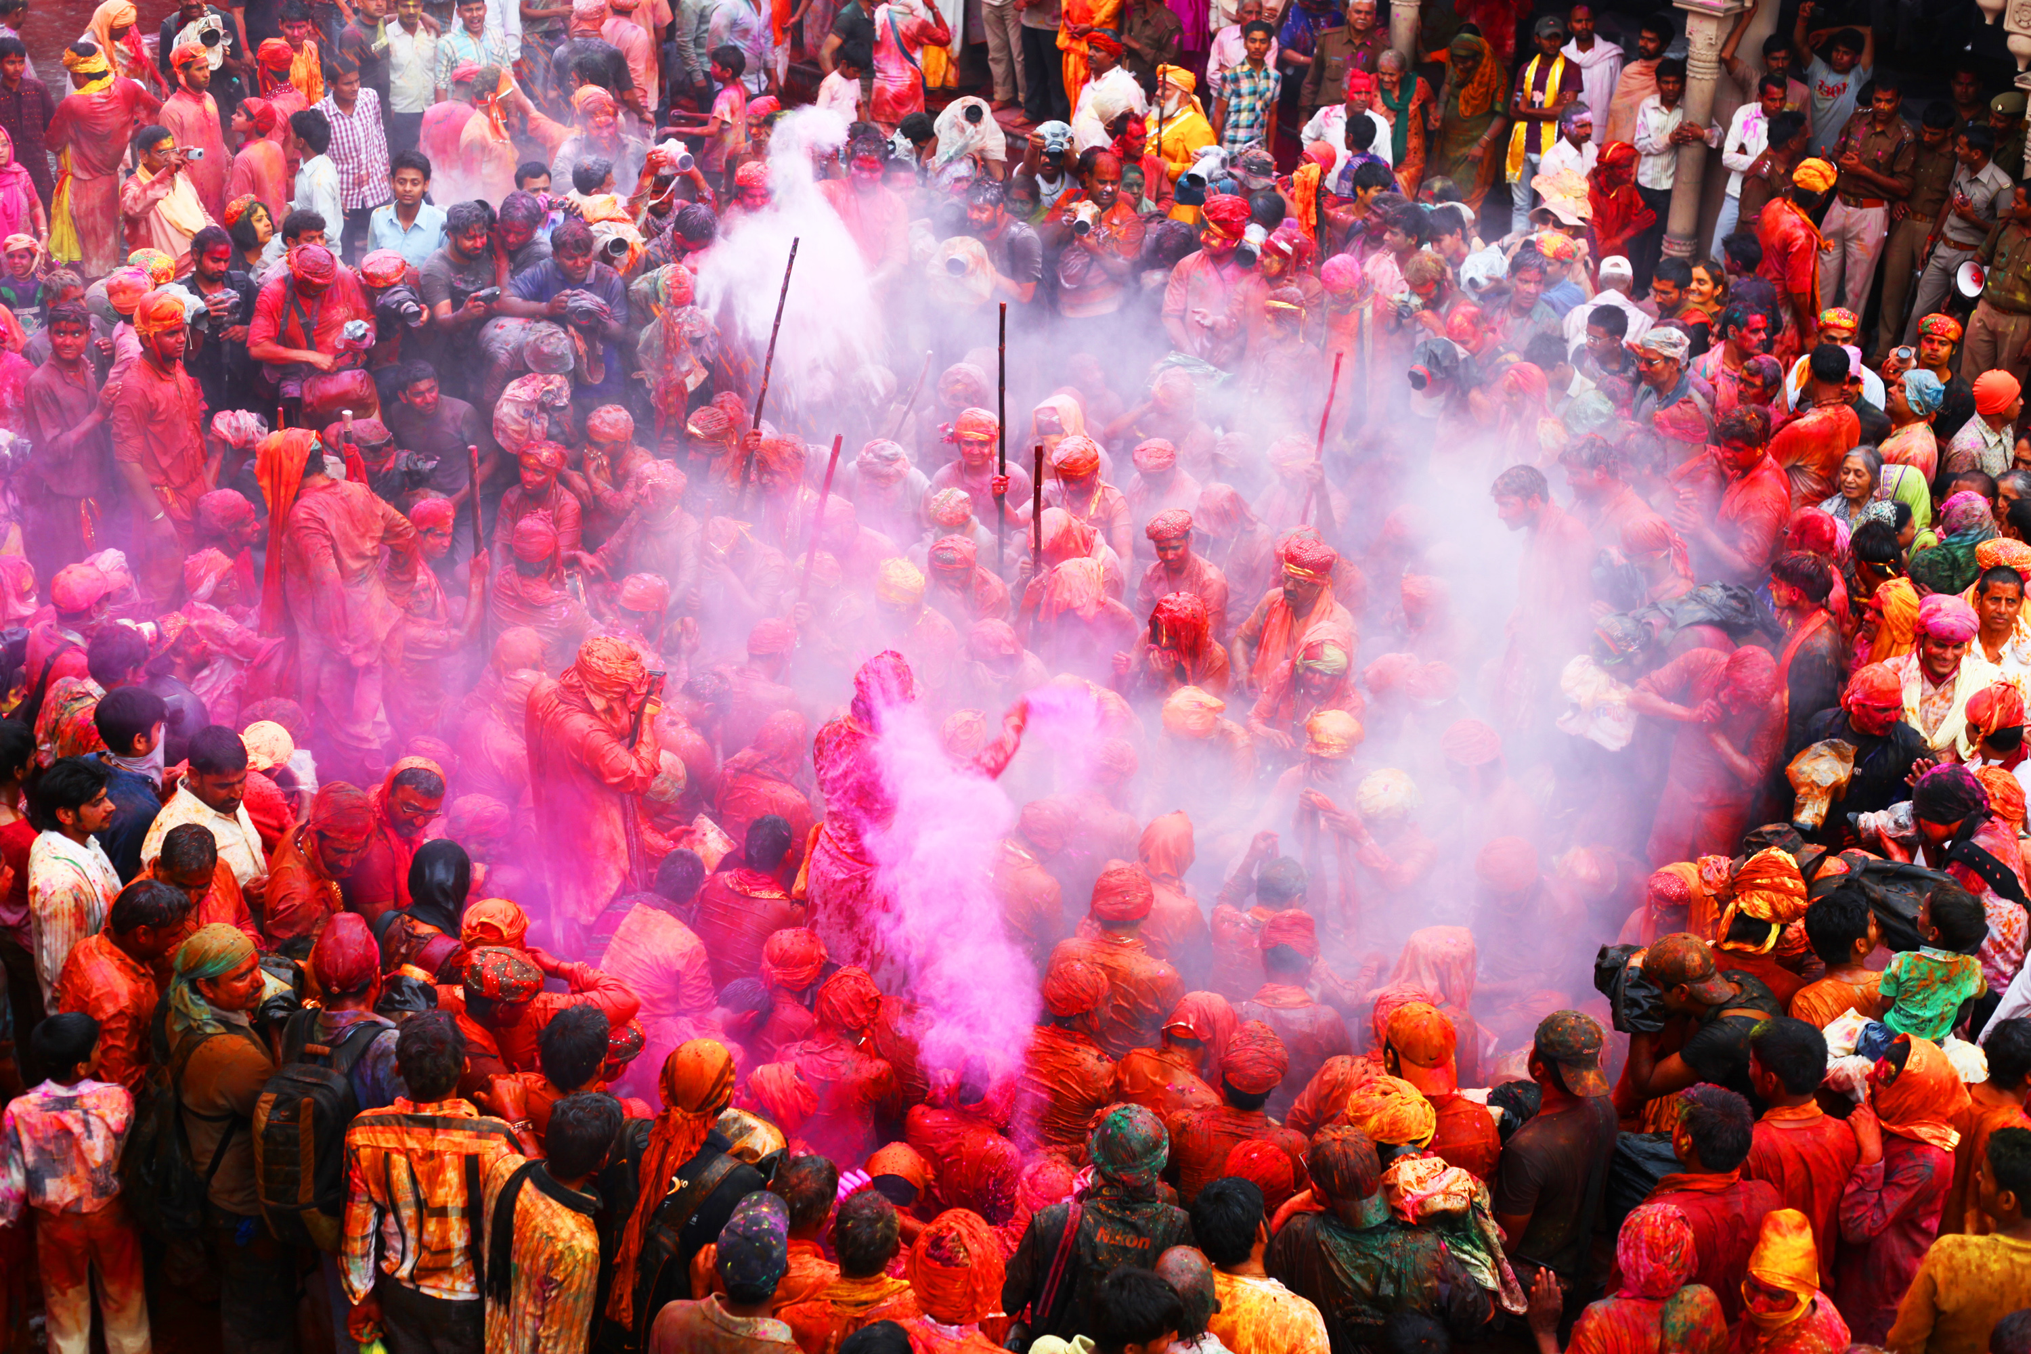
fEstival
Here is the list of 29 Indian Traditional Food - Indian States and Their Food Items to Awaken your Taste Buds
Misal Pav - Maharashtra. ...
Makki di Roti and Sarson da Saag - Punjab. ...
Kosha Mangsho - West Bengal. ...
Dhokla - Gujarat. ...
Rogan Josh - Kashmir. ...
Pongal - Tamil Nadu. ...
Papaya Khar - Assam. ...
Litti Chokha - Bihar.
Here is the list of 29 Indian Traditional Food - Indian States and Their Food Items to Awaken your Taste Buds
Misal Pav - Maharashtra. ...
Makki di Roti and Sarson da Saag - Punjab. ...
Kosha Mangsho - West Bengal. ...
Dhokla - Gujarat. ...
Rogan Josh - Kashmir. ...
Pongal - Tamil Nadu. ...
Papaya Khar - Assam. ...
Litti Chokha - Bihar.

Slide 9
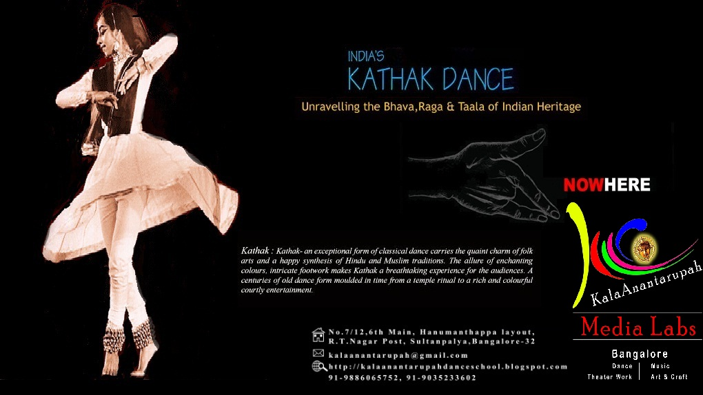
J

Slide 10
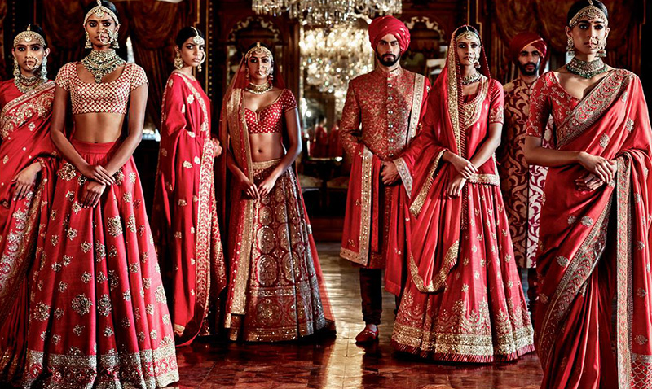
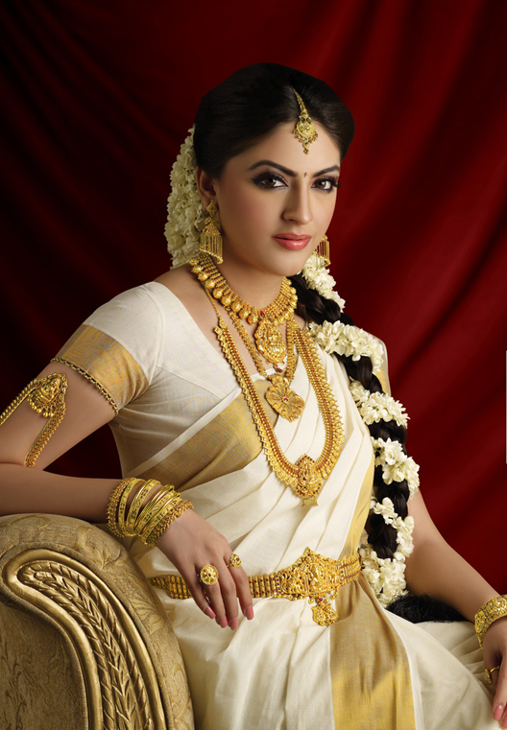
TRADITIONAL DRESS
Traditional india clothing for women across the country.
In india includes sari with choli tops , skirt called lehenga choli.

Slide 11
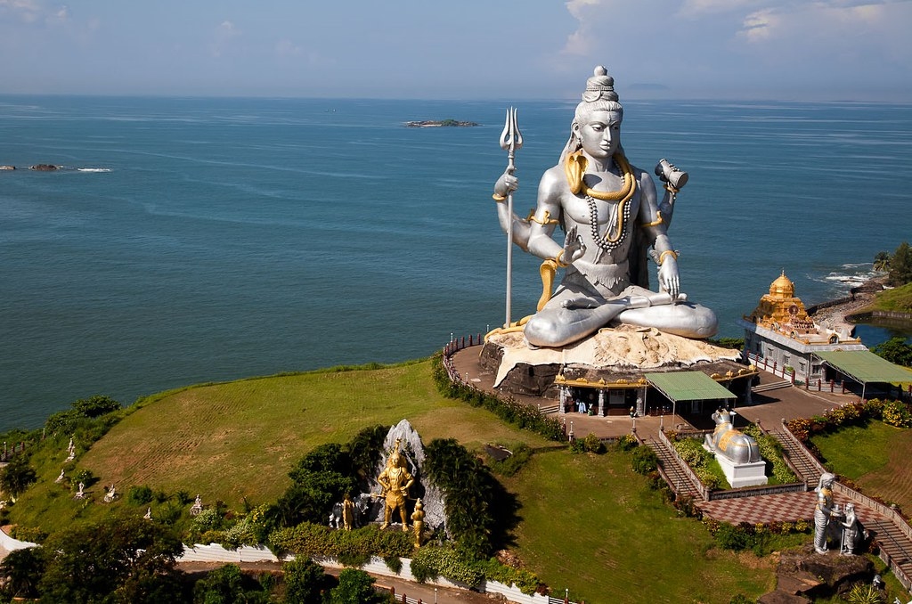
TEMPELS
Shiv mandir

Slide 12
THANK YOU
Tarannum khatun

